Slide 1

IT5305 – Machine Learning PBL
Final Project Review
Station-Level EV Charging Demand Forecasting
Presentation by
M PRAVEEN VIGNESH (210425205091)
J FARHAN SOHAIL (210425205059)
Department of Information Technology
Mentor
Dr. D. Nithya Baskaran
Associate Professor
Dept. of Information Technology

Slide 2
Abstract
Project Summary
Forecasts next-hour, site-level EV charging demand (kWh/h) for the Caltech workplace charging site from 6,490 real ACN-Data sessions. Six backward-looking features feed a chronologically evaluated Random Forest, benchmarked against a same-hour-last-week baseline and served through a local web dashboard.
Keywords: time-series forecasting, Random Forest, lag features, ACN-Data, demand forecasting
Dataset & Method
6,490 sessions, 53 stations, Apr–Aug 2018
2,555 hourly rows; 6 backward-only features
Chronological 80:20 split, never shuffled
Automated leakage test blocks future peeking
Headline Result
Baseline (same hour last week): MAE 8.86
Random Forest (tuned, final): MAE 4.41 (-50.2%)
Linear Regression: MAE 4.92 (-44.5%)
A decision-support prototype, not a controller

Slide 3
Introduction
Background
EV charging clusters at workplaces, where many vehicles plug in during the same few hours. Operators must know demand one hour ahead to stagger charging and manage grid capacity. A single station sits idle most hours, but a whole site shows a clear, repeating daily and weekly rhythm.
The Problem
A per-station series is ≈79% zero-demand hours
Site-level demand repeats daily and weekly
Caltech ACN-Data gives open session records
No commercial meter data is required
Driving Question
Can backward-only features beat the naive "same hour last week" rule?
Tested strictly chronologically — the model never sees the future
Answered on 478 held-out hours

Slide 4
Literature Survey
Approach
Five strands of prior work shape the method: an open charging dataset, a seasonal-naive benchmark, linear and tree-based regression, and the right error metric for a series that is often zero.
Data & Baseline
ACN-Data (Lee, Li & Low, e-Energy ’19) — open sessions + REST API
Seasonal-naive forecast (t−168h) — the weekly benchmark
Linear Regression on lag features — simplest learned model
Model & Metric
Random Forest (Breiman, 2001) — best performer here
MAE preferred over MAPE for a zero/near-zero series
scikit-learn, pandas, matplotlib — the stack

Slide 5
Objectives
Driving Question
"Can a model forecast next-hour, site-level EV demand more accurately than the same-hour-last-week rule, using only backward-looking features and a strictly chronological evaluation?"
Build & Validate
Ingest sessions via a retry-safe REST downloader
Aggregate to station- and site-level hourly demand
Engineer 6 backward-only features
Verify no leakage with an automated test
Evaluate & Deliver
Split chronologically; tune Random Forest by time-series CV
Compare vs. Linear Regression and the naive baseline
Score with MAE and RMSE on held-out hours
Serve predictions through a local JSON dashboard

Slide 6
System Requirements – S/W and H/W
Footprint
The entire pipeline — download, reshaping, tuning and training on 2,387 hourly rows — runs on a standard laptop in minutes, with no GPU, no notebooks and no paid services.
Hardware
Standard laptop (Windows 11 used)
No GPU required
Full pipeline completes in minutes
Software
Python 3.x; pandas, NumPy, scikit-learn
requests, joblib, matplotlib
Chart.js dashboard; VS Code; GitHub

Slide 7
Existing System
Status Quo
No learned forecaster is in use today. The practical rule of thumb is simply to repeat what happened at the same hour last week — easy to compute, but blind to the last few hours of real demand.
Baseline Rule
Prediction = demand 168h earlier (last week)
No training, no features, no model
MAE 8.86, RMSE 12.67 kWh/h on test hours
Why It Falls Short
Ignores the last 1–2 hours of real demand
Cannot adapt to an unusual day
≈79% station zero-demand hours defeat a per-station version

Slide 8
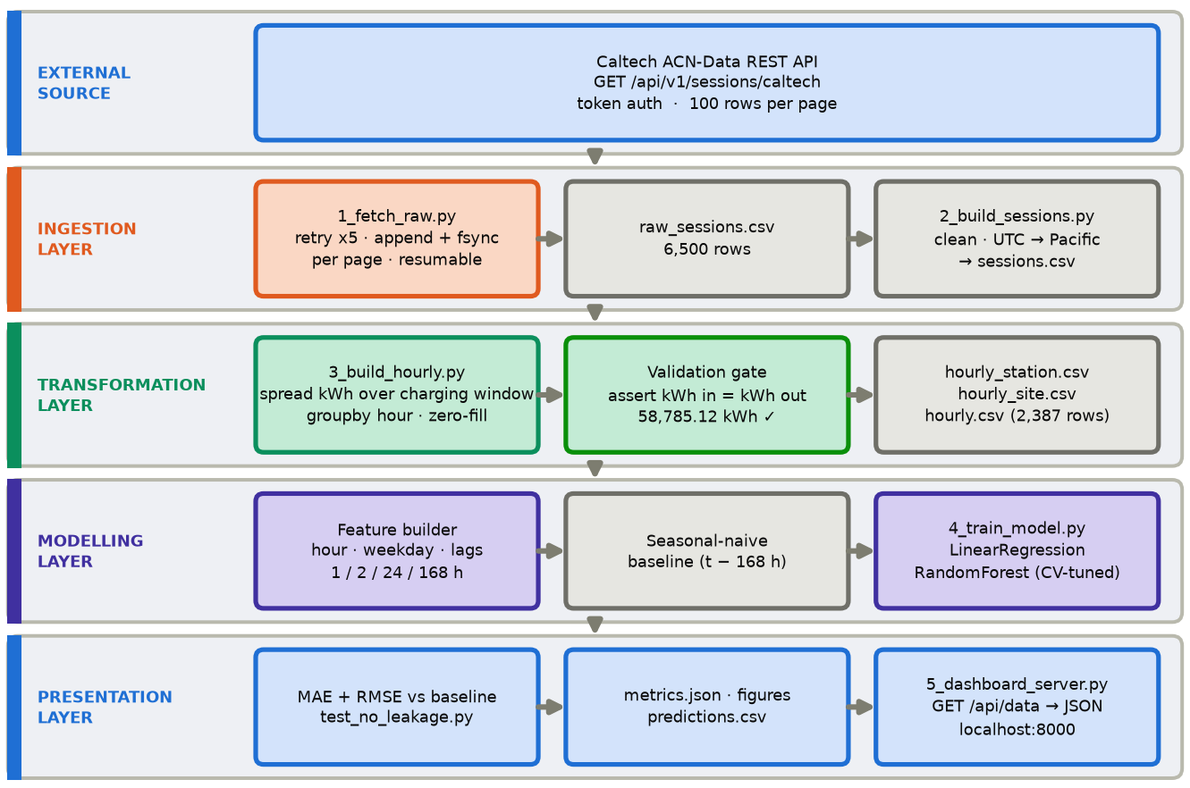
Proposed Methodology
Five one-way layers — ingestion, transformation, modelling, presentation — each validated before the next: the energy check confirms 58,785 kWh in equals kWh out.

Slide 9
Modules
Pipeline
Five scripts run in a strict ingest → transform → model → serve order, and share one feature builder (common.py). One script per stage keeps each step easy to test on its own.
Ingestion & Features
1_fetch_raw.py / 2_build_sessions.py — retry-safe download + cleaning
3_build_hourly.py — zero-filled hourly tables + energy check
common.py — shared backward-only feature builder
Modelling & Serving
4_train_model.py — baseline, Linear Regression, tuned Random Forest
5_dashboard_server.py — localhost:8000, /api/data JSON
test_no_leakage.py, make_figures.py — leakage test & figures

Slide 10
Results and Discussion – Metrics
Model | MAE (kWh/h) | RMSE (kWh/h) | Improvement vs Baseline
Baseline (same hour last week) | 8.86 | 12.67 | — reference rule
Linear Regression | 4.92 | 6.63 | 44.5%
Random Forest (fixed parameters) | 4.34 | 5.91 | 51.0%
Random Forest (tuned, final) | 4.41 | 5.97 | 50.2%
All metrics on 478 held-out, chronologically latest hours (20 Jul–9 Aug 2018). The cross-validated Random Forest is kept as the final model.

Slide 11
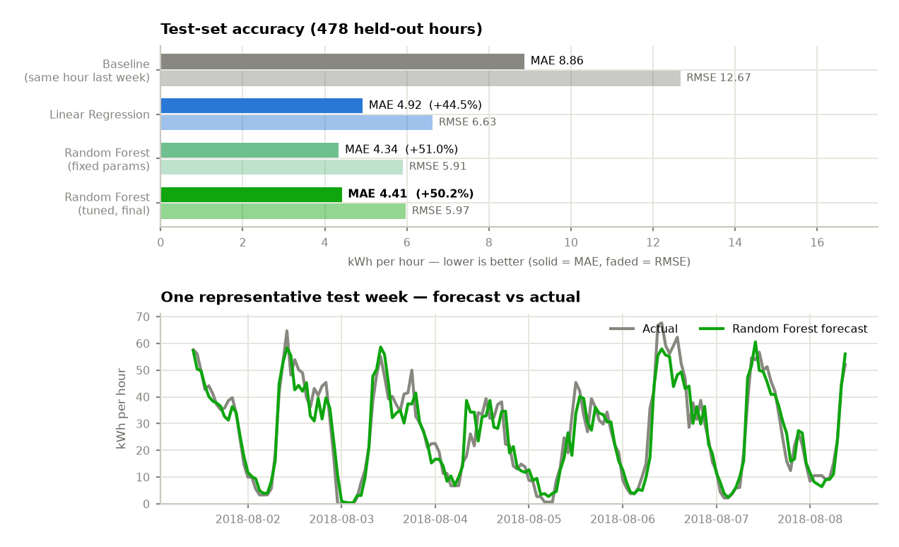
Results and Discussion – Charts
Forecast tracks the daily cycle closely but under-predicts the sharpest peaks (avg. 5.5 kWh/h low over the busiest 10% of hours). Top features: lag_1h 0.79, lag_168h 0.08, hour_of_day 0.07.

Slide 12
Future Enhancement
Next Steps
The prototype is accurate and honest about its limits. These extensions target stronger models, cleaner input data, longer horizons and a real deployment beyond a local server.
Modelling
Try Gradient Boosting with a wider tuning search
Build demand from metered power, not reconstructed sessions
Forecast more than one hour ahead
Test whether model differences are statistically meaningful
Scale & Deployment
Extend per-station models beyond the busiest five
Add weather, holidays and a longer, multi-site history
Deploy the dashboard as a hosted web application

Slide 13
Conclusion
Summary
A complete pipeline forecasts next-hour, site-level EV charging demand from 6,490 real sessions. The tuned Random Forest reaches MAE 4.41 kWh/h — 50.2% better than the same-hour-last-week baseline — and is served through a local dashboard.
Key Achievements
6,490 sessions → 2,555 hourly rows, energy-conserving
Random Forest MAE 4.41 (-50.2% vs baseline)
Leakage test proves features look only backward
All nine PBL phases completed
Honest Caveats
Without 1h/2h lags, the gain falls to 13.9%
Model under-predicts the sharpest demand peaks
One site, ≈3.5 months — not yet generalisable

Slide 14
References
Source Code & Data
Caltech ACN-Data: ev.caltech.edu/acndata · GitHub: Praveen-Vignesh/EV-Charging-station-demand-prediction
Data, Baseline & Theory
[1] Lee, Li & Low, ACN-Data (e-Energy ’19)
[2] Caltech, ACN-Data public API
[3] Hyndman & Athanasopoulos, Forecasting (2021)
[4] Hastie et al., Elements of Statistical Learning
[5] Breiman, Random Forests (2001)
[6] Hyndman & Koehler, Forecast Accuracy (2006)
Software Stack
[7] Pedregosa et al., scikit-learn (2011)
[8] scikit-learn: RandomForestRegressor
[9] scikit-learn: LinearRegression
[10] pandas development team, pandas docs
[11] Hunter, Matplotlib (2007)

